Slide 1
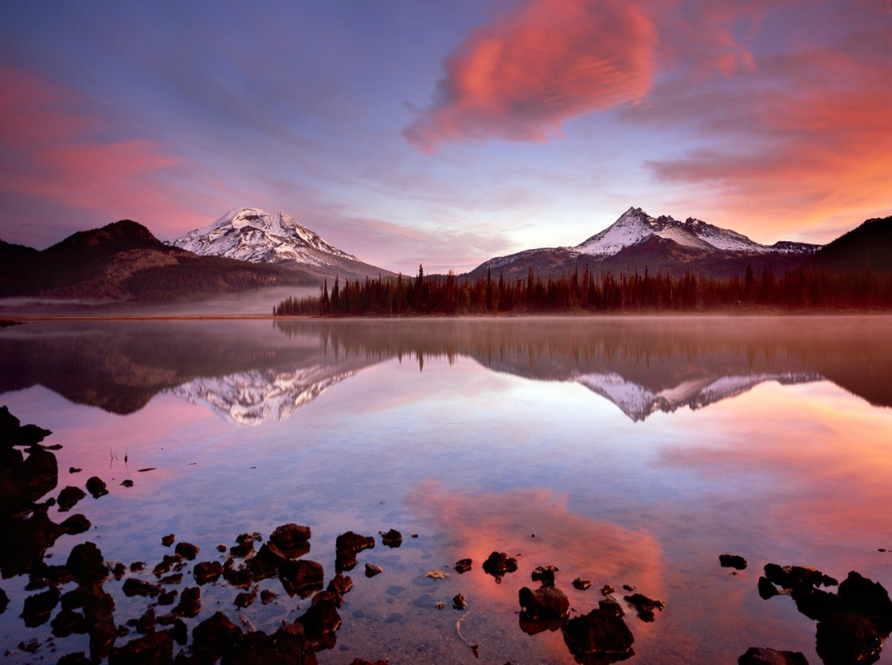
TSID Water Update
Jeremy Giffin
Deschutes Basin Watermaster
Oregon Water Resources Department
Carolyn Sufit
Central Region Manager
Oregon Water Resources Department

Slide 2
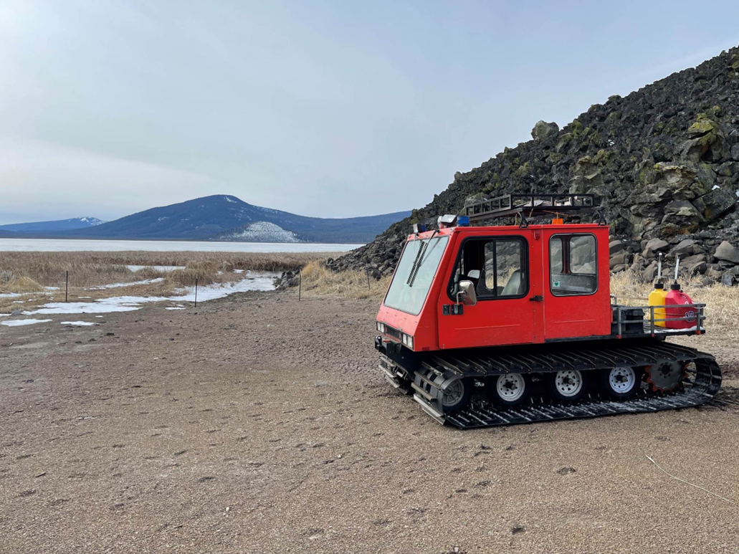
Talk Outline
Region Overview
Regional OWRD Role
Central Oregon’s Hydrologic History
Water Law/Water Rights Overview
TSID Water rights
Challenges
Drought
Conservation Efforts
2026 Water Outlook

Slide 3
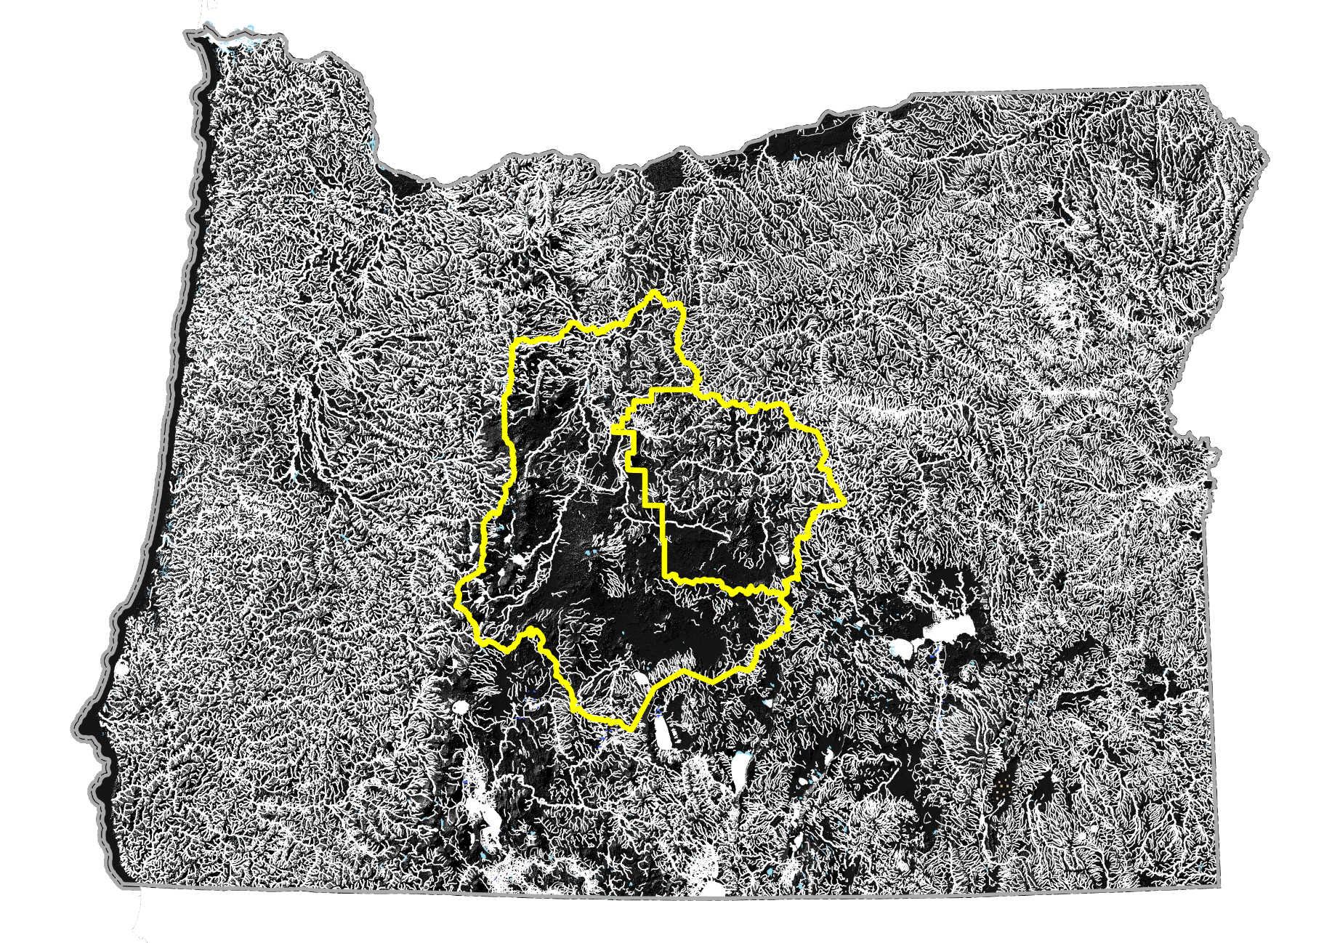
Central Region
District 11
Deschutes Basin
District 24
Crooked Basin
Notes:
Fully allocated surface water
1:1 surface water to groundwater connection
Competing water needs vs water scarcity
Canal infrastructure is some of the oldest and leakiest in the state
Leads the state in conservation efforts
Deschutes Basin Habitat Conservation Plan

Slide 4
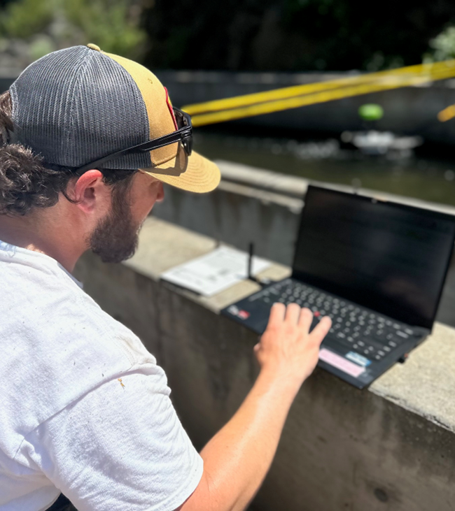
Central Region Overview
11,727 Square Miles
~3,500 Water rights
~125,000 acres of groundwater rights
~260,000 acres of surface water rights
~60 active gaging stations
Notes:
~60 active gaging stations in the region
Inflow, outflows, and district diversions
Basin conditions
Forecast basin water budget
Heavy measurement workload
Many of the gages below dams or diversions need to be measured bi-weekly to verify flows, all year round
Validation of data needed as flows and conditions change
Extremely engaged and educated regional water users

Slide 5
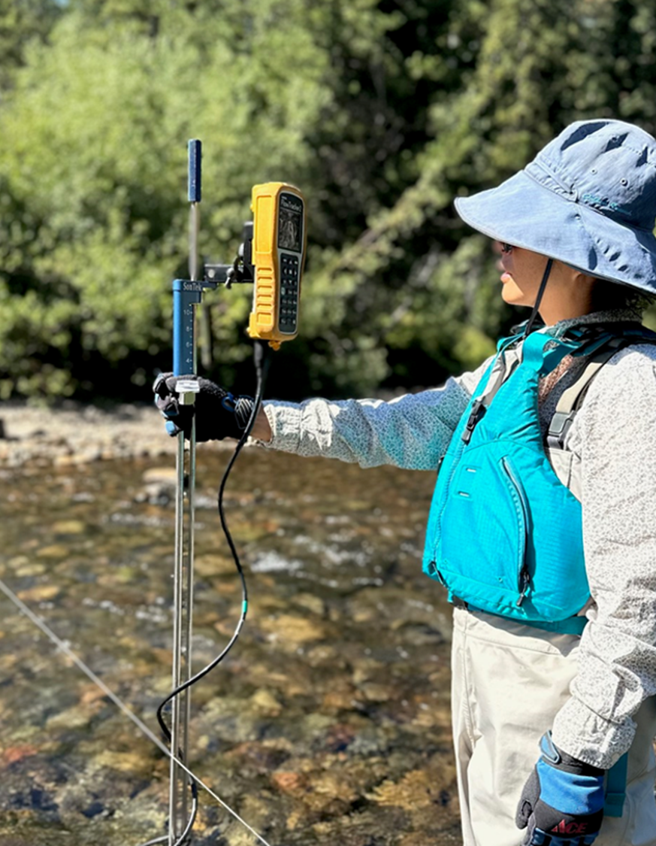
OWRD Regional Role
Distribution and regulation of surface water and groundwater
Regulation and curtailment in times of shortage
Monitor daily river flows and reservoir contents
Basin Storage Report
Dam Safety Inspections
Well Inspections
Notes:
Deschutes Basin watermaster (OWRD-state agency) has regulated and distributed the flows of the Deschutes basin for over 100 years.
Regulate Groundwater withdrawals of the Deschutes Basin
Monitor daily river flows and reservoir contents to rapidly respond to agricultural and environmental needs (HCP) and instream water rights
Guide hydrographic-related monitoring to accurately and quantitively for informed decision making through our network of 60 stream gages
Coordinate reservoir releases for irrigation demand with irrigation districts
Provide monthly storage report to irrigation districts to track all water usage
Curtail junior users in times of shortage

Slide 6
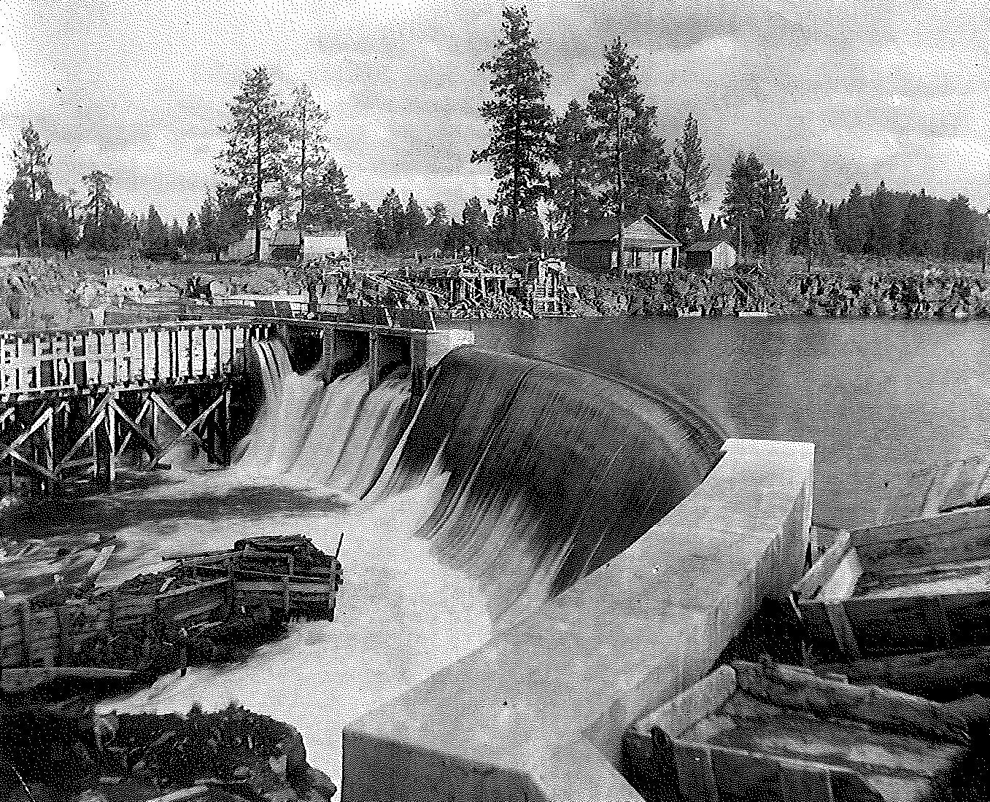
Deschutes History
Central Oregon largely passed by
Carey Act (1894)
Reclamation Act (1902)
Deschutes River fully appropriated (1913)
Reservoir development(1922-1949)
Gentleman’s agreement (1962)
Instream water rights act (1987)
Shift from timber and agriculture to scenic recreation in modern times

Slide 7
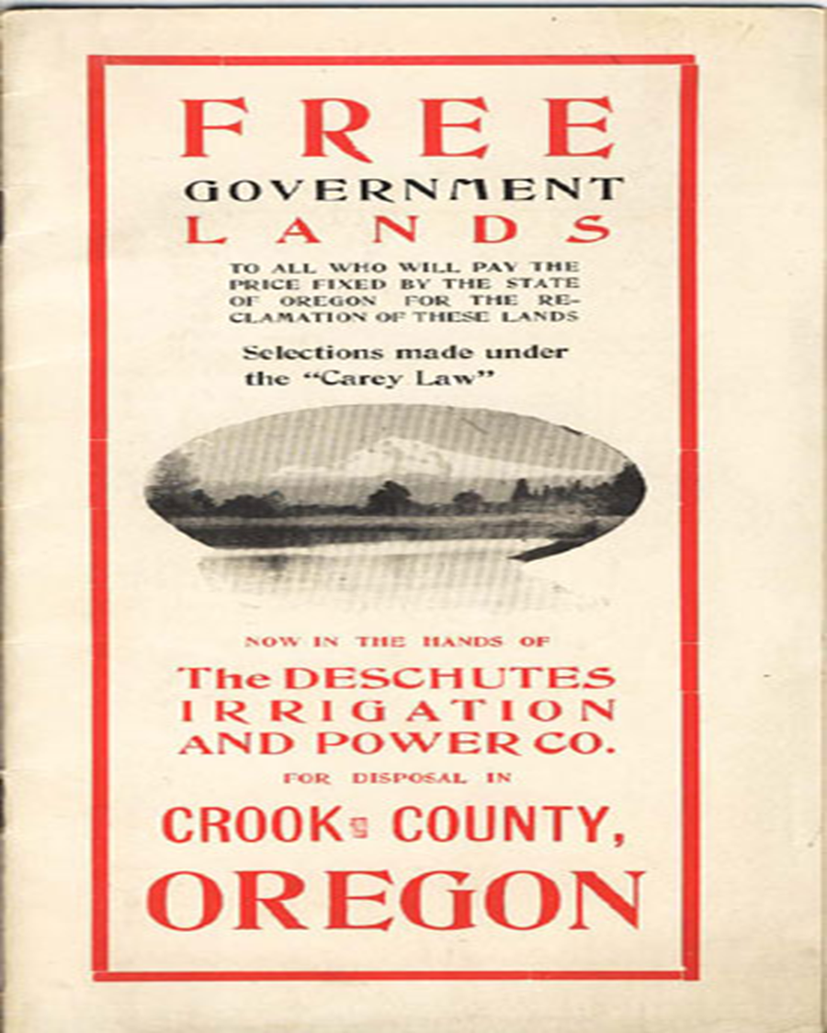
Carey Act (1894)
Oregon accepted the Carey Act in 1901 on condition that private developers front the capital to make the project viable.
Citizens given 160 acres of land as long as you irrigated at least 20 acres.

Slide 8
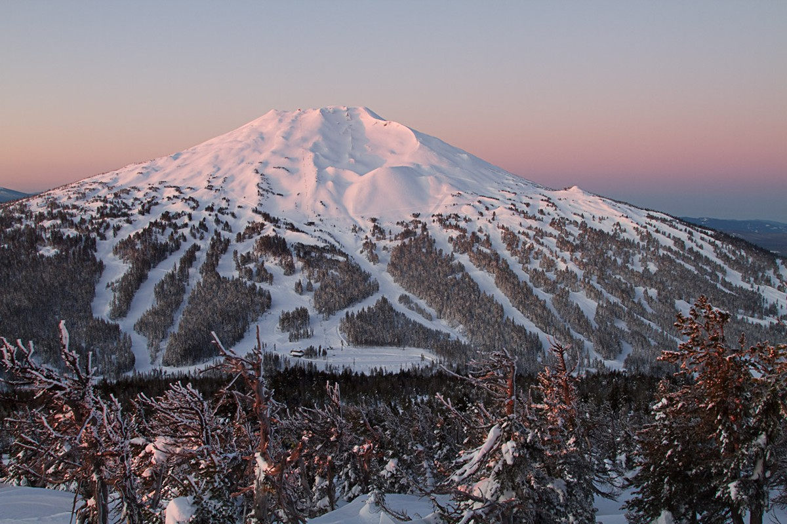
Geology and Geography
High Cascades
150 -200” precip/year
High Desert
Young lavas, tuffs, sands, gravels (very transmissive)
Large, porous “sponge” creates Deschutes aquifer
Spring fed system
Attenuated spring flow = drought resiliency
Minimal surface water flows

Slide 9
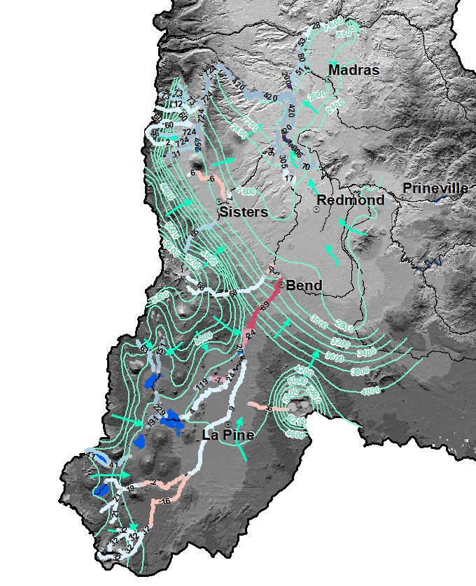
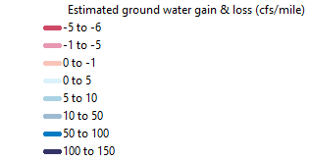
Deschutes River Basin: Surface and groundwater interaction

Slide 10
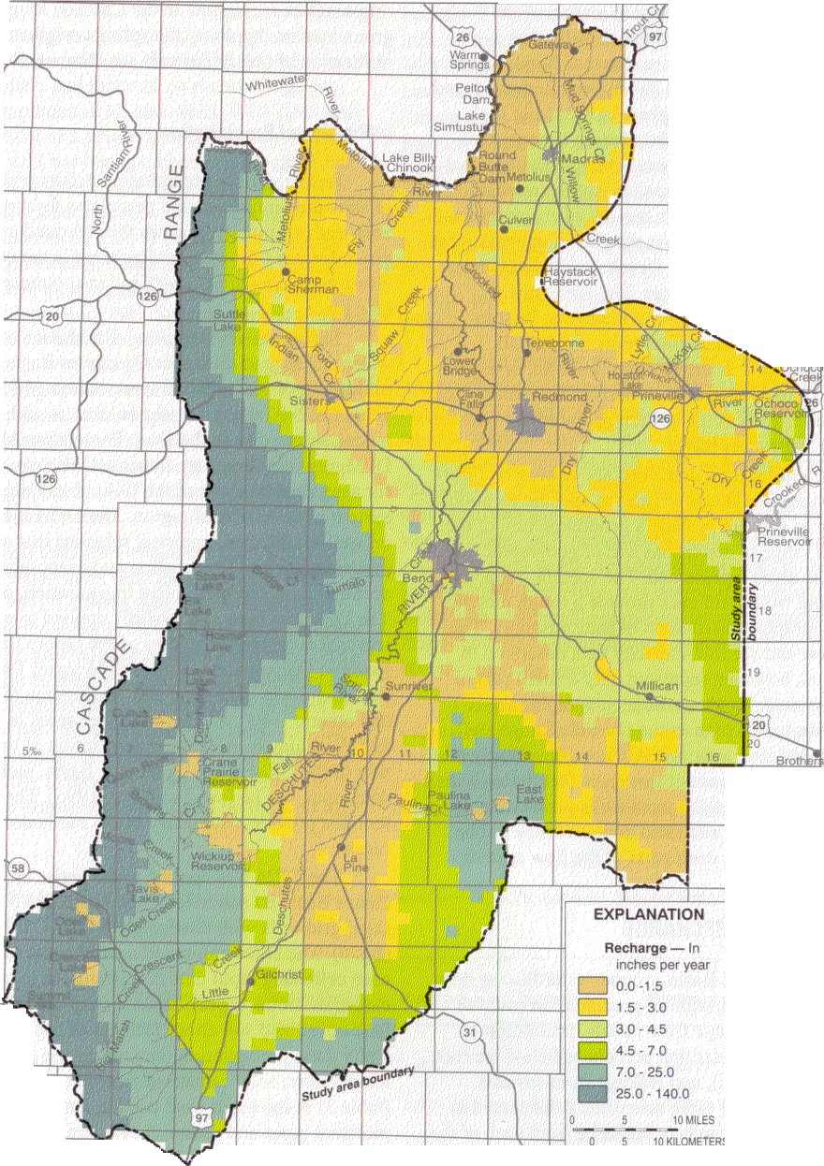
Groundwater Recharge
Where does aquifer recharge happen to give us our Deschutes River and robust aquifer?
Gains and Losses surface-groundwater in the upper watershed to Bend.
Groundwater reemerges around Crooked River Ranch, Opal Springs area

Slide 11
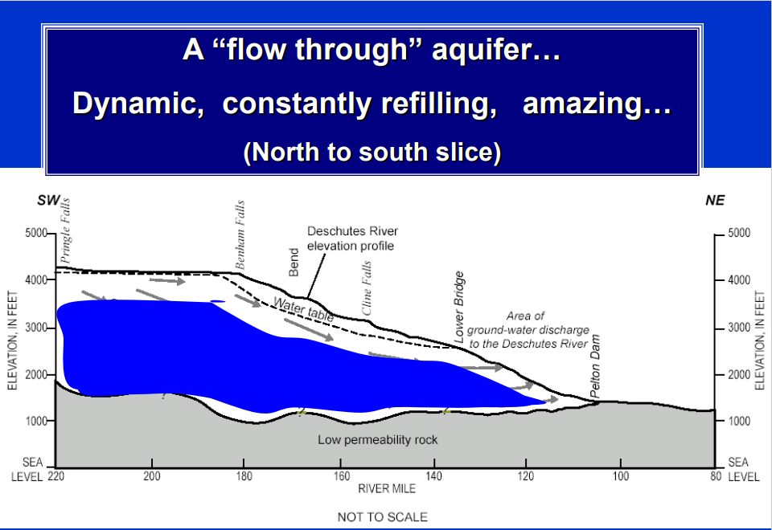

Slide 12
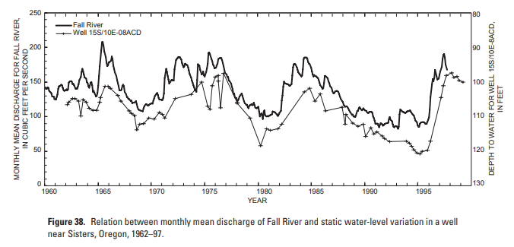
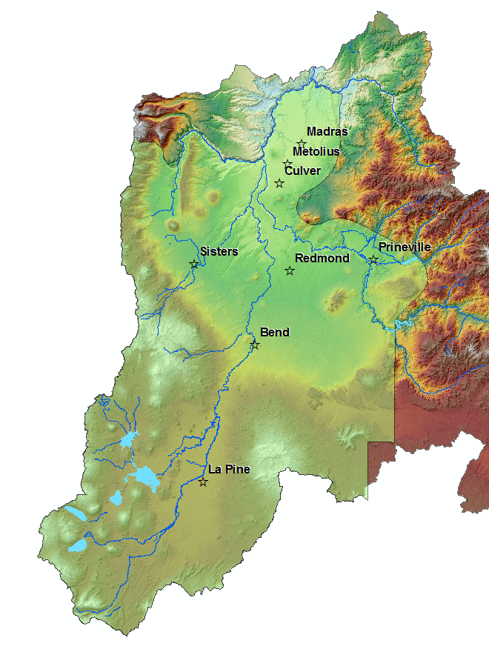
Upper Deschutes Groundwater Study and Mitigation
Surface water
Groundwater
Well
USGS/OWRD Ground Water Study 1998
direct connection between surface water and groundwater, thus Scenic Waterway would be affected by any new ground water rights.
Mitigation required for new ground water rights in the Deschutes Basin study area.
September 13, 2002 rules adopted for mitigation and mitigation banks (Division 505 and 521).
HB 3494 passed in 2005 confirming mitigation rules..
Fall River
Upper Deschutes Zone of Impact

Slide 13
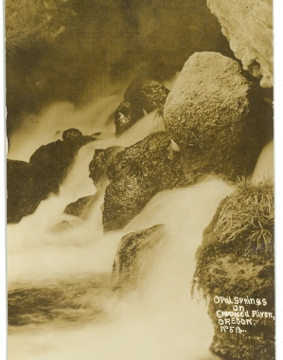
Groundwater Mitigation
Offset new consumptive use with existing surface water right
2005 appeals ruling overturns rules
HB 3494
Met 50% of the time
Zones of impact
200 CFS mitigation cap

Slide 14
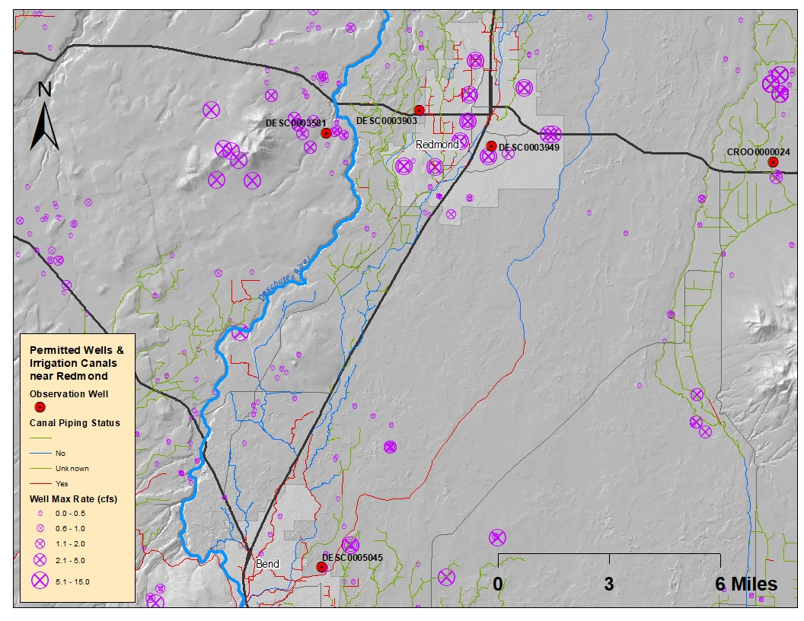
Groundwater Trends
*Canal lining as of 2016

Slide 15
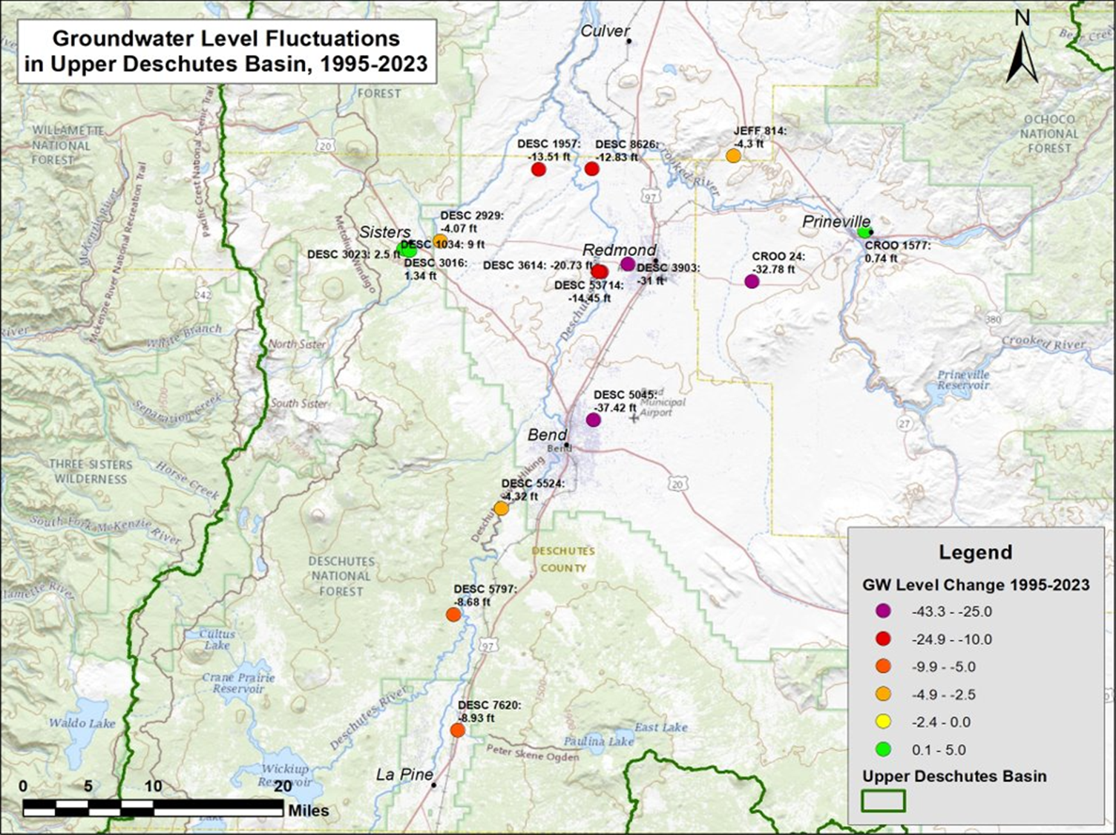
Groundwater Trends

Slide 16
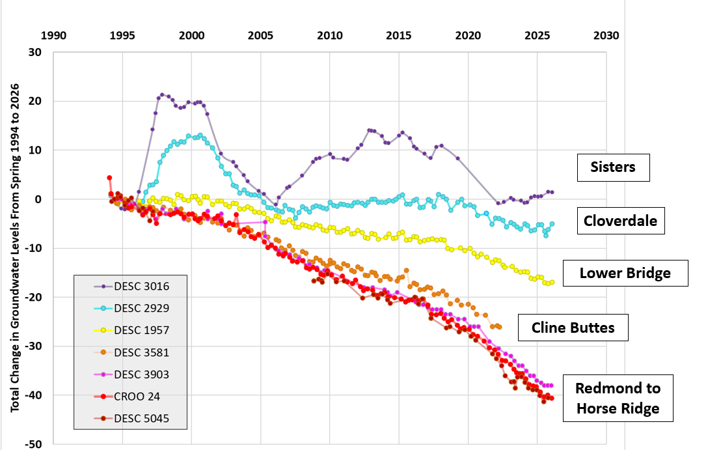
Groundwater Trends

Slide 17
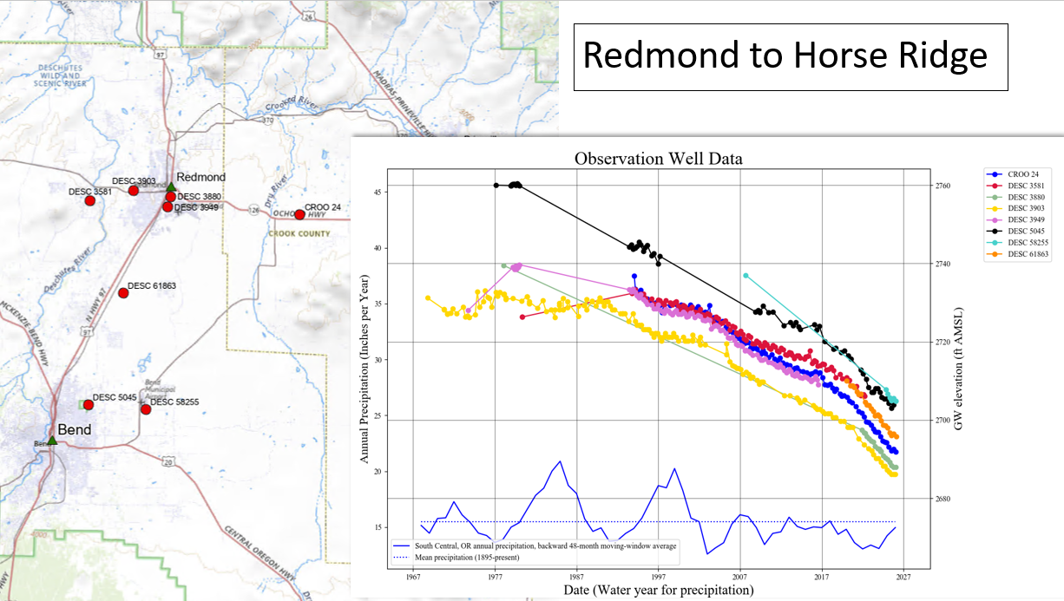
Groundwater Trends

Slide 18
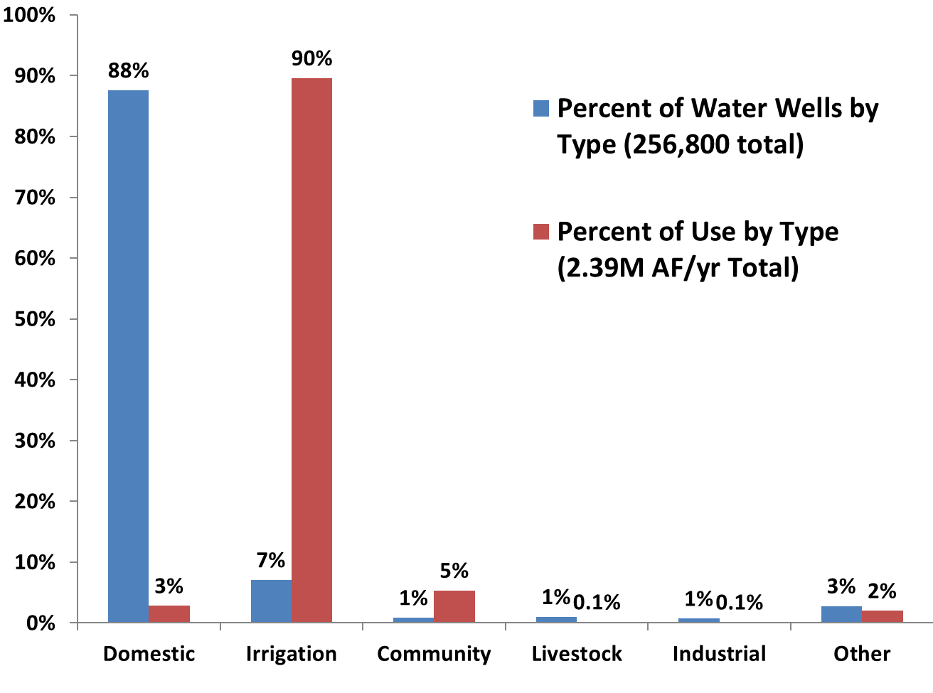

Slide 19
Water Right Development History: Oregon
Pre 1909
Court based
Disputes settled through court decrees and adjudications
1909-Present
State administered permit process
Requires approval before new water appropriations
Centralized records
Formalized prior appropriation

Slide 20
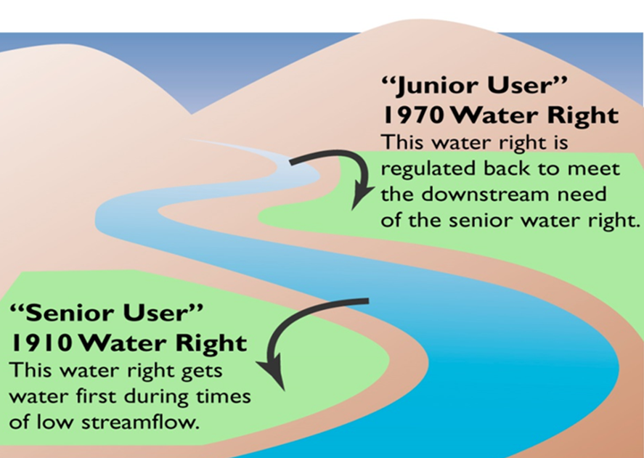
Key Tenets of Oregon Water Law
Public Resource
First in time, first in right (priority)
Beneficial use without waste
Appurtenance
Water must be used
Notes:
One of the key tenets of water law is that all water belongs to the public. With some exceptions, cities, irrigators, businesses, and other water users must obtain a permit or license from the Water Resources Department to use water from any source. This applies regardless of whether the water is groundwater or from lakes or streams.
[time: 24 seconds]

Slide 21
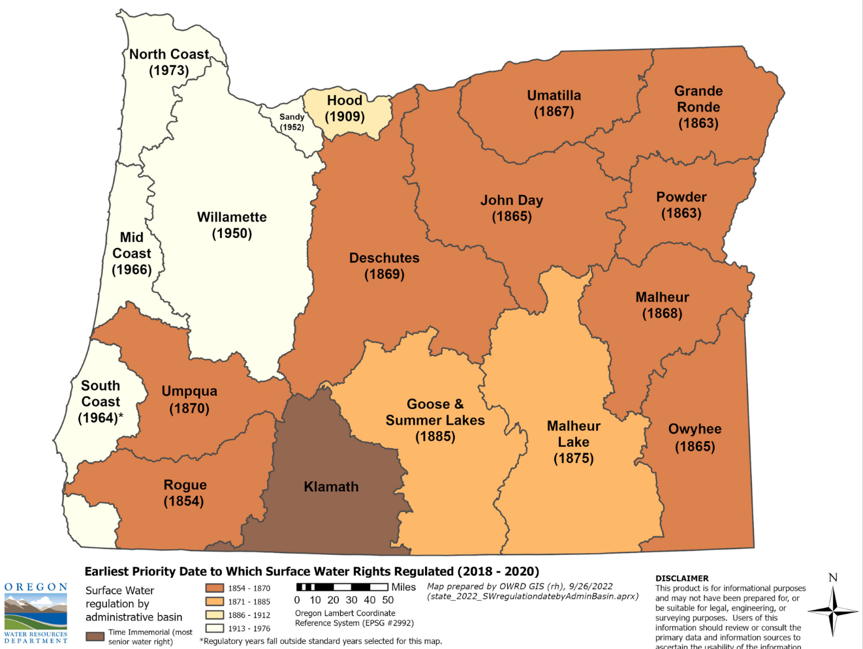
Key Tenets of Oregon Water Law
Public Resource
First in time, first in right (priority)
Beneficial use without waste
Appurtenance
Water must be used
Notes:
We previously discussed the prior appropriation doctrine, or first in time, first in right. This slide shows the earliest priority date that is satisfied after regulation on one stream in each water basin. This is the worst-case scenario in each basin, but in general, surface water in many places in the state has been over-allocated for over 100 years. There has not been enough water in most years to meet surface water rights issued since the mid to late 1800s in the east and southwest parts of the state. In the wet northwest part of the state, there has not been enough water in most years to meet surface water rights issued since the mid-1900s. An early priority date is significantly advantageous in water scarce years.
[time: 45 seconds]

Slide 22













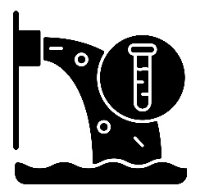

Key Tenets of Oregon Water Law
Agricultural
Commercial
Domestic
Fish Life
Public Resource
First in time, first in right (priority)
Beneficial use without waste
Appurtenance
Water must be used
Irrigation
Livestock
Mining
Municipal
Power
Public Instream Use
Recreation
Wildlife
Wetland Enhancement
Pollution Abatement
Industrial
Notes:
Beneficial use is the foundation and the limit of a water right. Beneficial use means the reasonably efficient use of water without waste for a purpose consistent with the laws, rules and the best interests of the people of the state. While there is no exhaustive list of beneficial uses, some common beneficial uses are shown on this slide, such as irrigation, fish life, and municipal use. A water right for any of these uses would be limited to the amount of water that could be used without waste.
[time: 28 seconds]

Slide 23


Key Tenets of Oregon Water Law
Public Resource
First in time, first in right (priority)
Beneficial use without waste
Appurtenance
Water must be used
Permit
Personal Property Right
Certificate
Property Right (appurtenant)
Notes:
Another key tenet of water law is appurtenance. We refer to a water right being appurtenant to the land. This means that once a permitted water right is developed and we issue a certificate, it is a type of property right and is attached to the land described in the right. If the land is sold, the water right typically goes with the land to the new owner unless the water right is specifically excluded in the deed.
[time: 23 seconds]

Slide 24
Key Tenets of Oregon Water Law
Water rights must be used within their terms and conditions at least once every five years
Otherwise, subject to forfeiture and cancellation
Exceptions may apply
ORS 540.610
Public Resource
First in time, first in right (priority)
Beneficial use without waste
Appurtenance
Water must be used
Notes:
A water right must be used consistent with the terms and conditions of the right. Terms include, but are not limited to, the water source, where the water is accessed, where the water is used and for what purpose, how much water can be used, and when it can be used. Water rights also include conditions to protect the public interest. Failure to beneficially use a water right at least once every five years may result in a forfeited water right. This means the water right may be lost unless the water right holder demonstrates that one or more statutory exceptions apply. For example, the water right holder may provide evidence that they were ready, willing, and able to use the water but were unable to make full beneficial use of the water because water was not available from the authorized source. This could occur because of drought or the water right being regulated off. Another exception to forfeiture includes full use of the right not being necessary due to climatic conditions, such as cooler weather or precipitation.
[time: 47 seconds]

Slide 25
Transferring a Water Right
Change the place of use, character of use, point of diversion, or add a point of diversion
Maintains original priority date
Analysis of evidence of beneficial use or that the right is not subject to forfeiture
Analysis for injury to another user or enlargement of original right
Notes:
The use of water under a water right is restricted to the terms and conditions described in the water right certificate. Permit terms include the source of water and priority date, place of use, point of diversion or point of appropriation (a well), and type of use. For example, if a water right holder establishes the right to irrigate a particular 20-acre tract of land, the water cannot be diverted from a different point or source, nor can it be used to irrigate other land. It cannot be used for any other purpose than the type of use indicated in the water right. The water right holder must file a transfer application with the Department to change a point of diversion, point of appropriation, type of use, place of use, or any combination of these. It is not possible to change a water right's source of water or priority date with a transfer application.
In order to approve a transfer, the transfer applicant must provide evidence that the water right was beneficially used in accordance with the terms and conditions of the water right within the 5 years prior to submittal of the transfer application. In other words, they must demonstrate that they actually used the water right recently. In addition, the transfer cannot result in injury to another user nor result in enlargement of the original water right being transferred. ---
• Injury occurs when, as a result of a transfer, another existing water right no longer receives previously available water to which it is legally entitled.
• Enlargement occurs when a transfer would result in such things as increasing the number of acres irrigated or using a greater rate or volume of water.
If the transfer is approved and the applicant successfully makes the changes, a new certificate maintaining the original priority date is issued.
[time: 1 min, 37 seconds]

Slide 26
The Water Right Permit System
Application
“Priority Date”
When a completed application is received, the priority date is assigned.
If approved, a permit is issued. Water use must begin in accordance with the permit, and the user must submit a report on the beneficial use of the water.
Permit
With some exceptions, if the water right is not used for more than five consecutive years, it may be considered forfeited and could be cancelled.
“Proving Up”
Certificate
Non-Use
A water right holder may change their diversion location, place of use or type of use.
Change How Used
Transfer
Cancellation
Notes:
Obtaining a water right is a 3-step process. First, an applicant submits a water right application. The date we receive a complete application establishes the tentative priority date for any permit that may be issued. Permit issuance starts a clock, which is typically 5 years, during which the permit holder must develop their water right consistent with permit conditions. Within this window, the permit holder complies with any conditions that must be satisfied prior to using water. They develop their water use infrastructure and begin beneficial use of water consistent with the terms and conditions of the permit. An example of what this might look like for a surface water right for irrigation is that the applicant would install their pump or headgate, along with a fish screen to prevent fish from entering the water use infrastructure. They would install these components at the point of diversion prior to taking water from a stream. They would develop their pipeline to transport the water from the stream to their field and may install center pivots. They would then begin irrigating a crop consistent with the terms and conditions of the permit. The user has one year from making full beneficial use of water to submit a report to the Department. The Department reviews this claim of beneficial use and, if the user has successfully proved up on their water use, the Department issues a water right certificate. If a water right holder wishes to change their certificated right, they may file for a transfer. A water right may be subject to forfeiture and cancelled if it is not used for five consecutive years.

Slide 27
Exempt Uses: Surface Water
Rainwater from an artificial impervious surface
Emergency fire-fighting
Fish screens, fishways, and fish by-pass structures
Forest management
Land management practices (soil conservation, water quality)
Livestock watering must meet certain conditions
Notes:
A water right permit or license from the Department is required to use water from any source in the State of Oregon, with some exceptions. These exceptions are called exempt uses and are specified in statute. There are exemptions for both surface water and groundwater. A couple examples of exempt uses of surface water are rainwater collected from a roof, and emergency fire-fighting.

Slide 28


Exempt Uses: Groundwater
Group or single domestic use (household): Not exceeding 15,000 gallons per day.
Stock watering
Irrigation of lawn and/or garden of a half-acre or less: No more than a half-acre in area. Irrigation of larger areas requires a water use authorization and is not exempt.
Beginning Jan. 1, 2026, commercial gardens not exceeding a half-acre and using no more than 3,000 gallons per day will qualify as exempt.
Industrial or commercial purposes: Not exceeding 5,000 gallons per day, including the 3,000 gallon per-day cap on commercial gardens of one half-acre or less.
Watering school grounds: < 10 acres for schools located within CGWA
Down-hole heat exchange purposes: A closed geothermal loop to provide source heat.

Slide 29
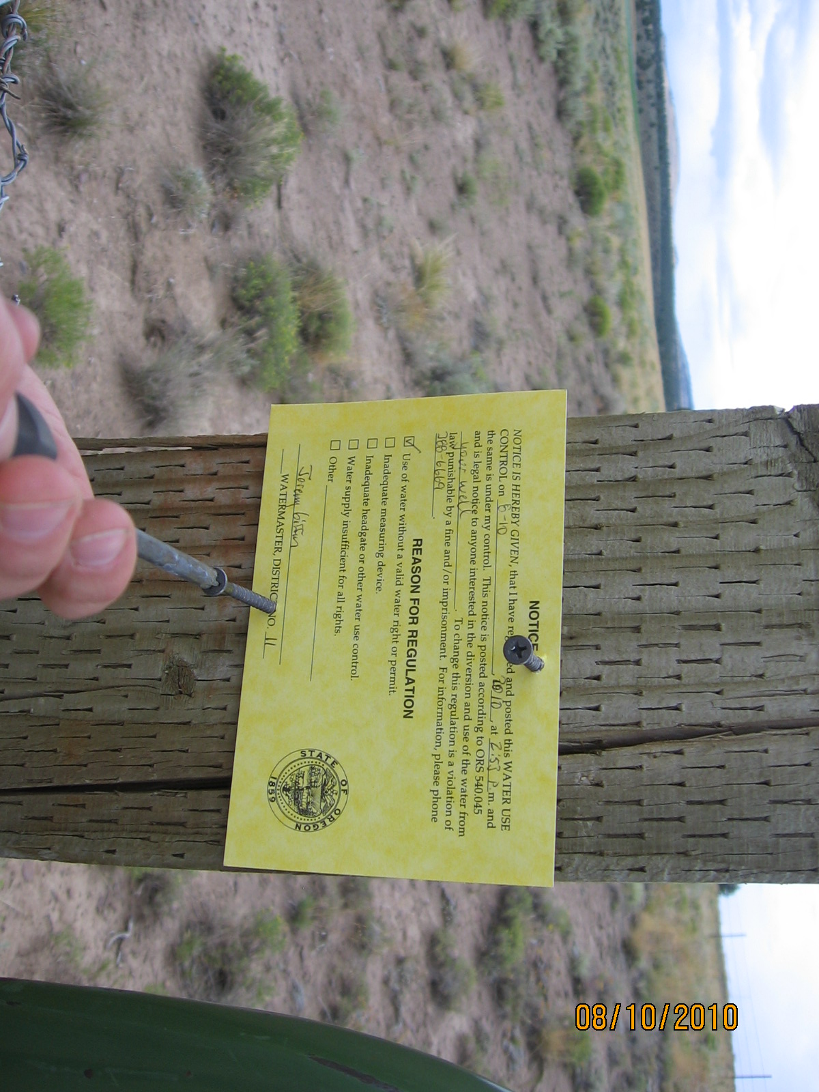
Regulating Water Use
Pre-Code Water Rights and Adjudication
No such thing as a grandfathered water right
Application/Permit/ Certification Process
Conditions, conditions, conditions
Groundwater Rights
Mitigation requirements
Well ID tag requirements

Slide 30
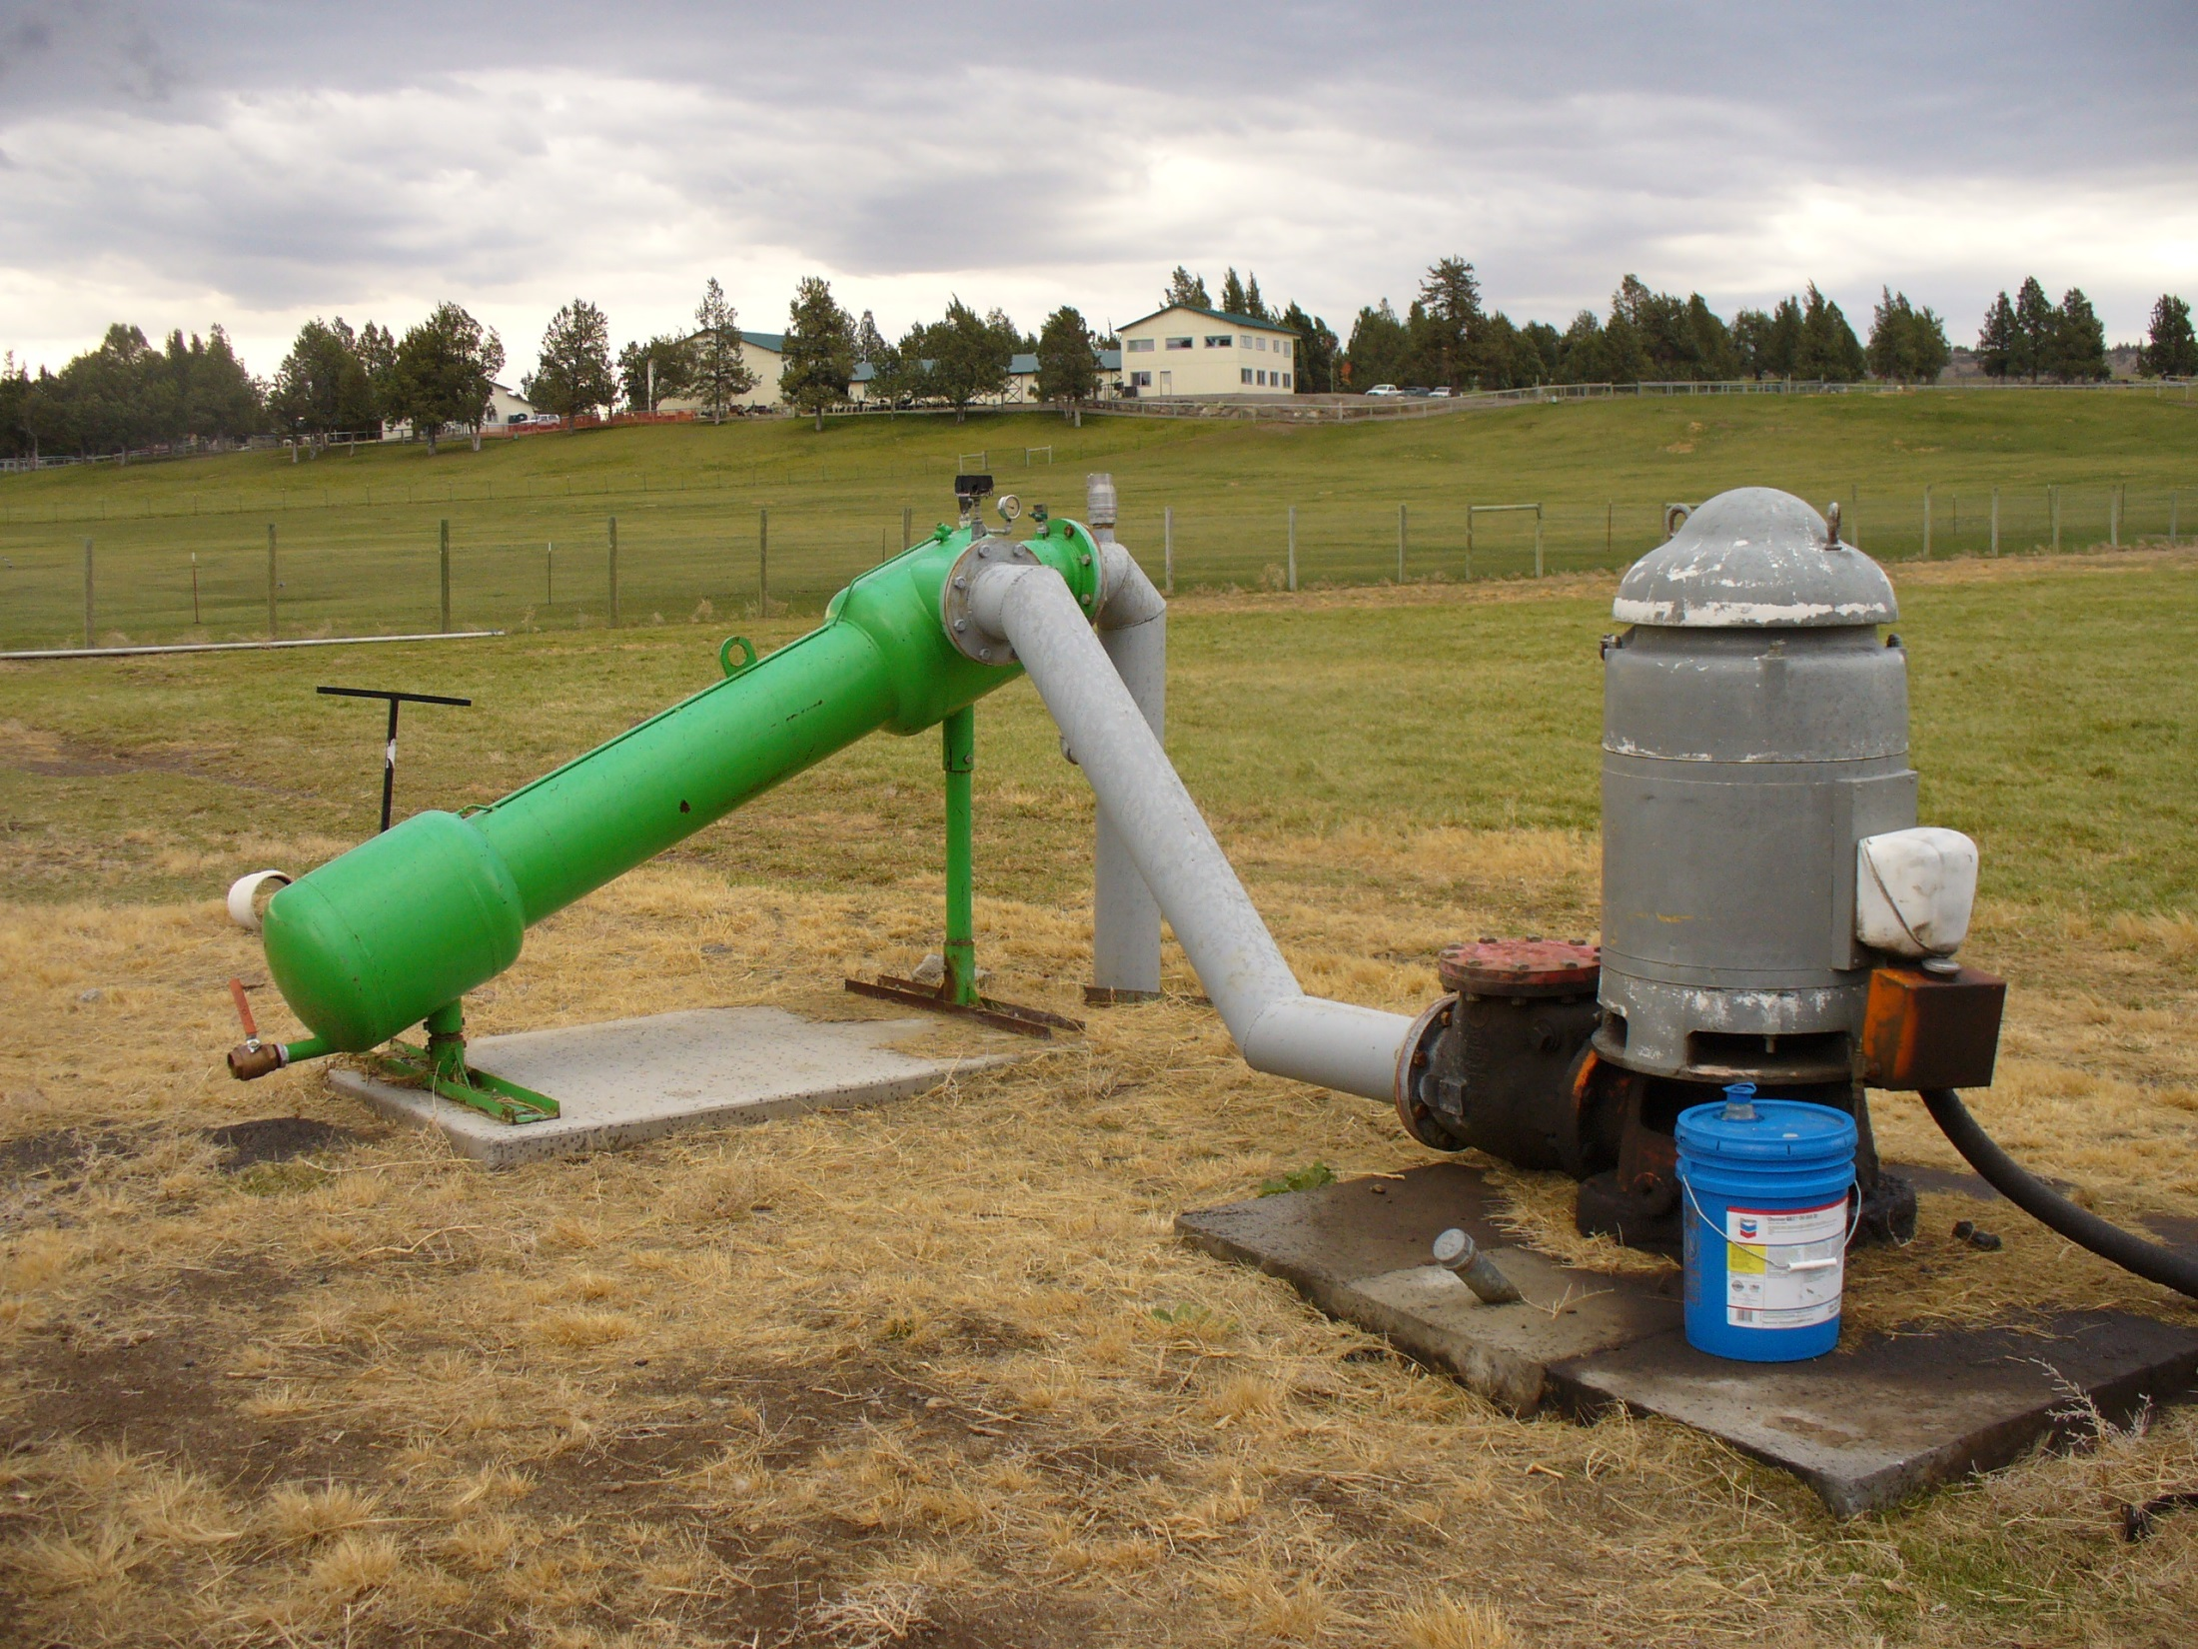
Well ID Program Requirements
Required since 1996 (ORS 537.789-537.793).
Required to be installed when properties sell.
No fee for a well ID tag.
Unique to each well.
Helps in future searches and water rights
Must provide map with start card (2009 SB 788 required map and $300 Fee)
Fee to maintain well log database

Slide 31
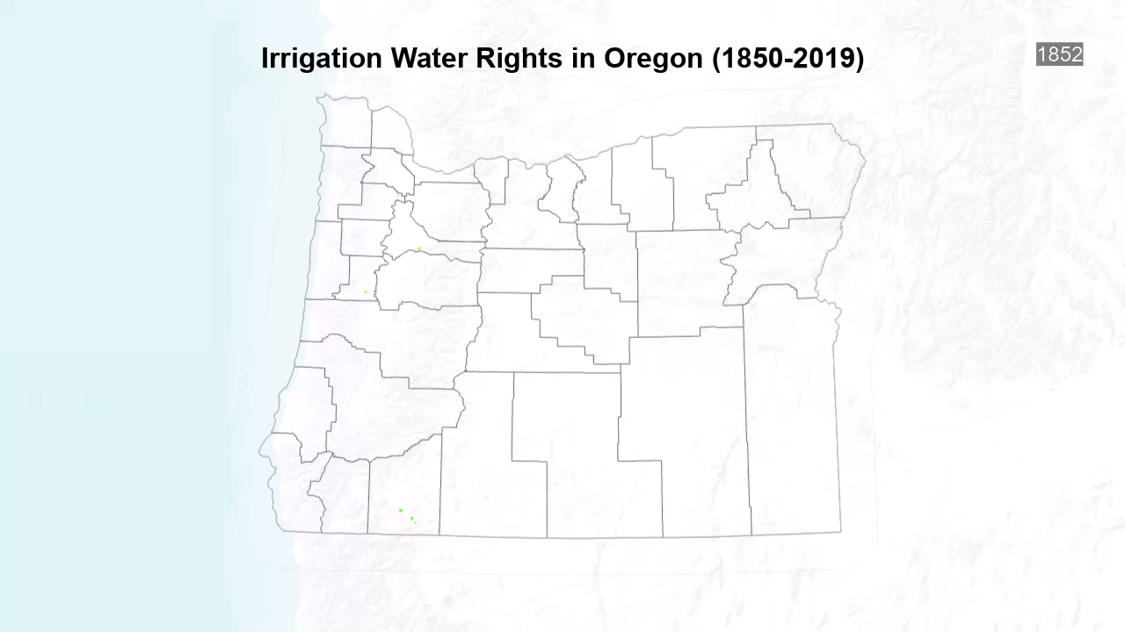

Slide 32
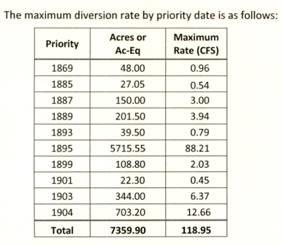
TSID Water Rights
TSID Certificate 95971 (living)
Main certificate 95971 from Whychus Creek.
Supplemental irrigation Watson Reservoir Certificate 95972.
Watson reservoir storage right Permit R-3902.
Supplemental irrigation GW Certificate 97771.
3 Inline Hydro rights Certificates 87798, 92035 & 95164.
McKenzie canyon reregulating reservoir Certificate 31339.
Other surface water Certificates 298, 79496, 87944 & 88554.

Slide 33
TSID Challenges
Water supply directed related to snowpack and precipitation
No large scale storage facilities
Lots of other senior users share Whychus Creek.
Large diurnal swings in flow
“Runoff” stream subject to large rain event floods
Does not have a large spring flow to buffer low water years
Lots of Ice issues due to the high cold water
LOTS of other users vs Water Scarcity

Slide 34

Declaring Drought
How droughts are declared in Oregon
Under ORS 536.700-780, a drought emergency can be declared by the governor by local (county) jurisdictions
The statue also allows for a statewide declaration, but that is rarely utilized
A county generally requests a drought declaration from the Governor
The Governor then refers the request to the Drought Readiness Council (DRC)
The DRC works with the Water Supply Availability Committee (WSAC) to evaluate the request

Slide 35
Declaring Drought
How droughts are declared in Oregon
Water Supply Availability Committee responsibilities
Evaluate stream flow, snowpack, reservoir levels, precipitation models, temperature models, etc.
Drought Readiness Council responsibilities
Evaluate the request based on condition information from the WSAC, partner agencies, socioeconomic conditions ,etc.
Both WSAC and DRC then make a recommendation to the Governor to approve or deny the request

Slide 36
Declaring Drought
How droughts are declared in Oregon
OWRD is the lead agency for drought emergencies
A drought declaration under ORS 536 authorizes the use of OWRDs Drought Mitigation tools as described in OAR 690-019 (Drought Mitigation)
Division 19 details the drought tools available and their applicability
http://www.oregon.gov/owrd/law/docs/law/oar_690_019.pdf

Slide 37
Existing Drought Tools
Overview of Drought Specific Tools
Emergency Water Use Permits
Temporary Transfer
Temporary Instream Lease
Temporary Substitution
Special Option Agreements
Temporary Exchange of Water
Human Consumption or Stock Water Use Preference
Requiring Development and Implementation of Curtailment or Conservation Plans
Full description / definitions available here: http://www.oregon.gov/owrd/docs/HB4113/Draft_Final_Task_Force_Report_11_1_2016_Final.pdf

Slide 38
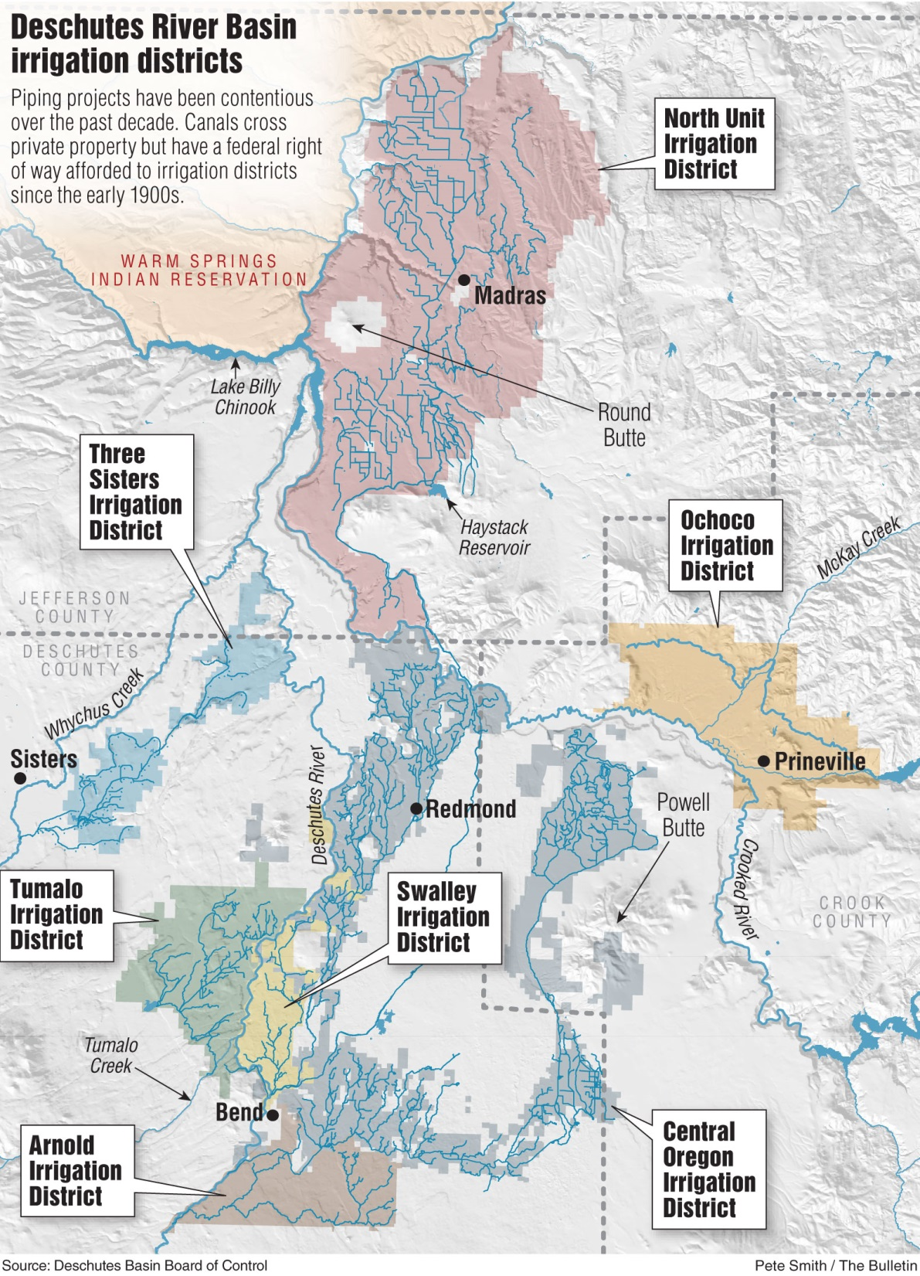
Conservation: Leasing and Irrigation Districts
Most of leasing is with irrigation districts
8 Districts in Central Oregon
Divert about 95% of water
Diversions have been decreasing since 1960’s
Sprinklers, measurement, piping, lining, instream transfers and leases & conservation.

Slide 39
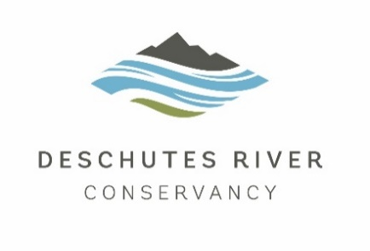
Conservation Efforts Instream Leasing
Notes:
Retains priority date
Beneficial use the second it goes instream
Versatility in water management
Held in trust by the state
1-5 years, cancel anytime
Reverts automatically to original use
Tumalo, Whychus and zero protected flow below Bend
Now a healthy fishery on T, W, and 140 cfs in Bend
- 1000 of parcels (maybe brief note on workload)

Slide 40
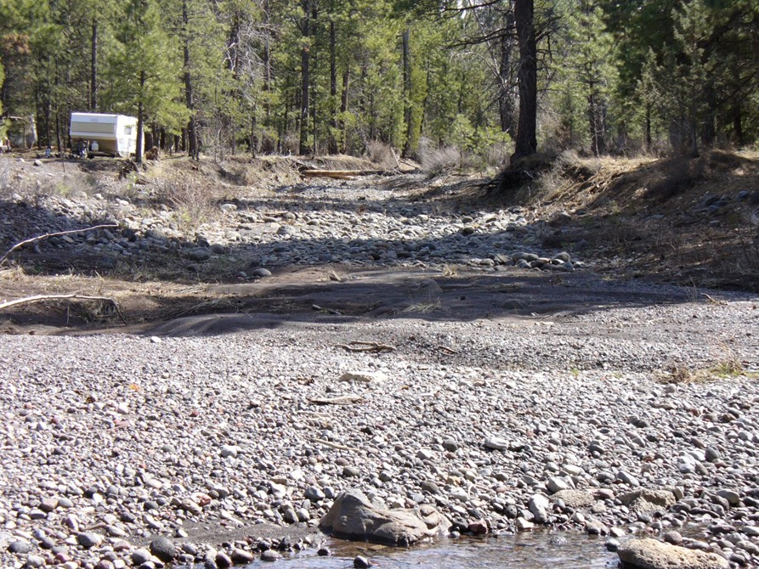
Instream Water Rights
Whychus Creek below TSID diversion prior to 1998
1987 Instream Water Right Act
Held in Trust by the State
Applied for By State Agencies-Junior
Bought transferred instream-Senior
Over 200 in Deschutes Basin

Slide 41
Conservation Efforts Allocation of Conserved Water
Notes:
ACW has been wildly successful in this basin
2/3 of ACW efforts have been in the Crooked and Deschutes basins
Up until the HCP, the ACW was one of the primary mechanisms to putting water in-stream
Why didn’t it work? Middle D was beneficiary, to support HCP flows were needed in Upper D
*not all department grants, includes streams outside of mainstem Deschutes/Crooked

Slide 42
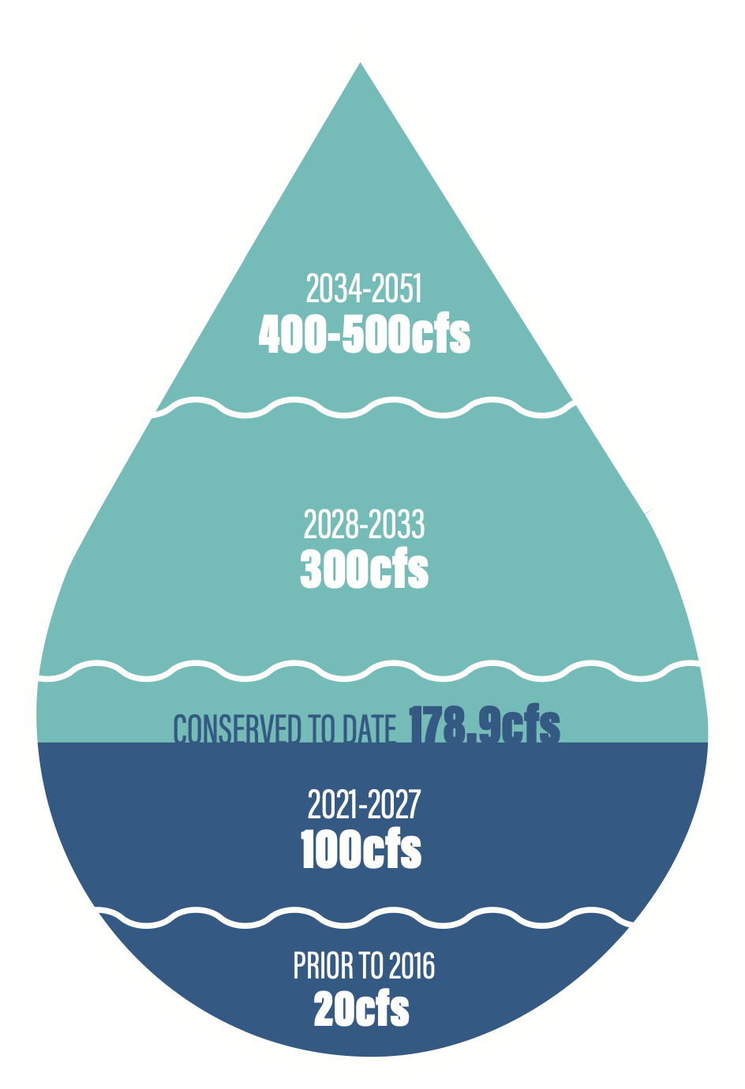

Conservation Efforts Deschutes Basin Alternative Pathway
Voluntary pathway for conserved water projects in response to HCP requirements
Conserved live flow goes to NUID for irrigation
Equivalent Wickiup storage released by NUID in winter for flow augmentation
Legal protections ensure water stays instream

Slide 43
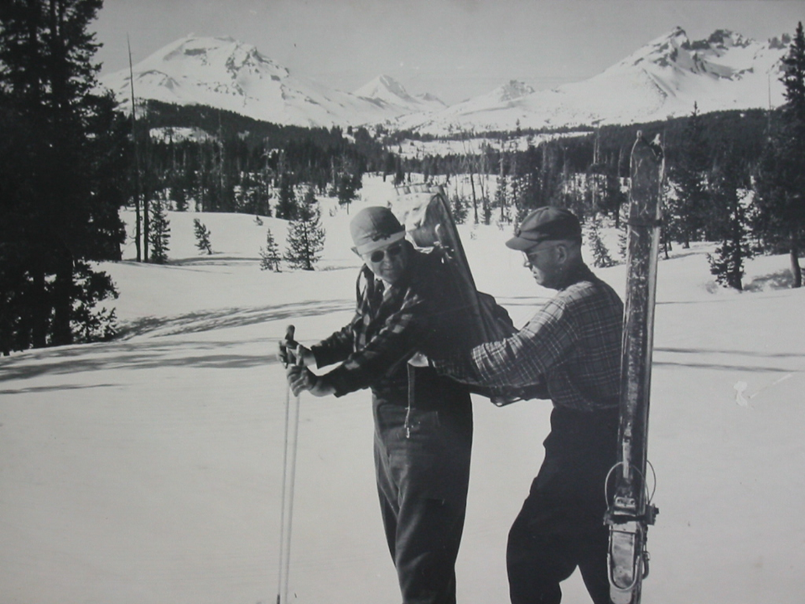
Questions?
www.oregon.gov/owrd (our website)
https://apps.wrd.state.or.us/apps/sw/hydro_near_real_time/ (NRT)
www.or.nrcs.usda.gov/snow/data/current.html (SNOTEL)
www.usbr.gov/pn/hydromet/destea.html (Deschutes Basin Interactive Gages)
Jeremy.T.Giffin@Oregon.gov
(541) 306-6885
Aubrey Perry (Watermaster 1933-1960) and Jack Frost (NRCS) measuring snowpack in Dutchman Flat area Circa 1940-1945.

Slide 44
Thank you!
Presenter’s Name
Email address | Phone number

Slide 45
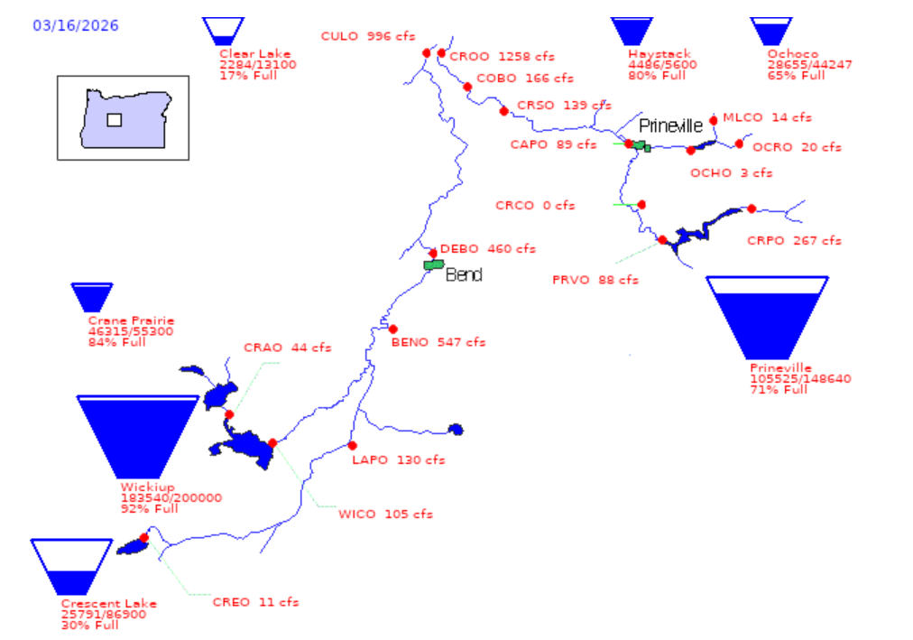
Overview of the “teacups” as of March 16 2026:
Wickiup 92% Full
Prineville 71% Full
Ochoco 65% Full
Haystack 80% Full

Slide 46
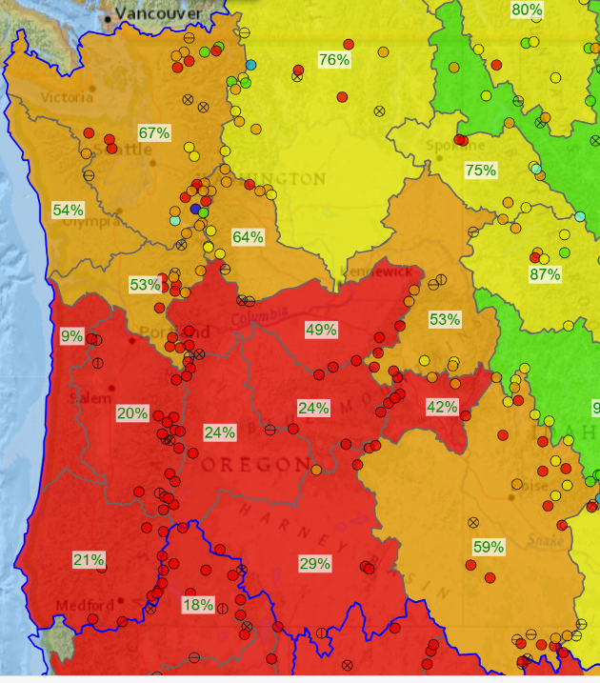
SNOWPACK in the PNW as of 3/17/26:
24% of Normal

Slide 47
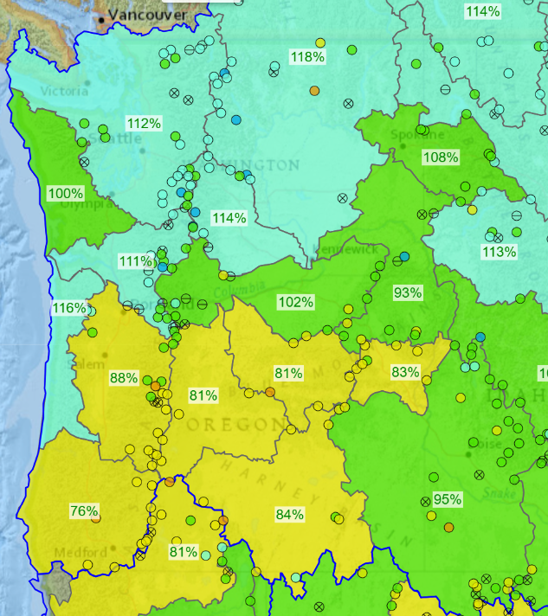
Water Year PRECIPITATION in the PNW as of 3/17/26:
81% for the Deschutes

Slide 48
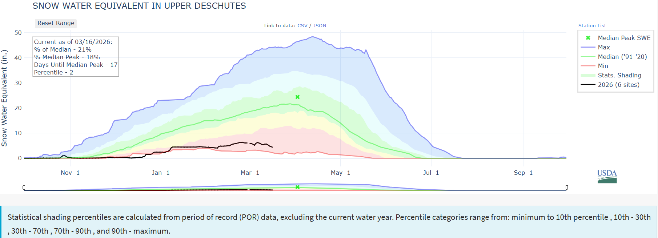
SNOWPACK in the Upper Deschutes
Black Line is this year
Green line is average
21% of Normal

Slide 49
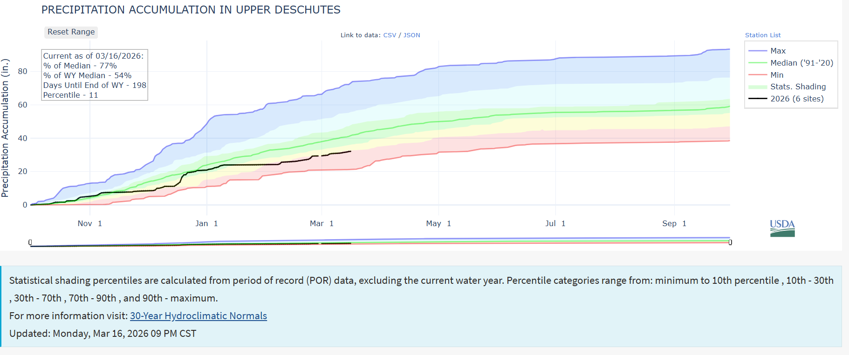
PRECIPITATION in the Upper Deschutes
Black Line is this year
Green line is average
77% of Normal

Slide 50
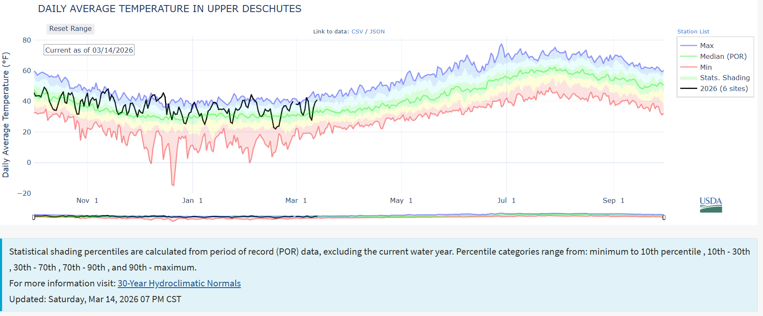
Temperatures

Slide 51
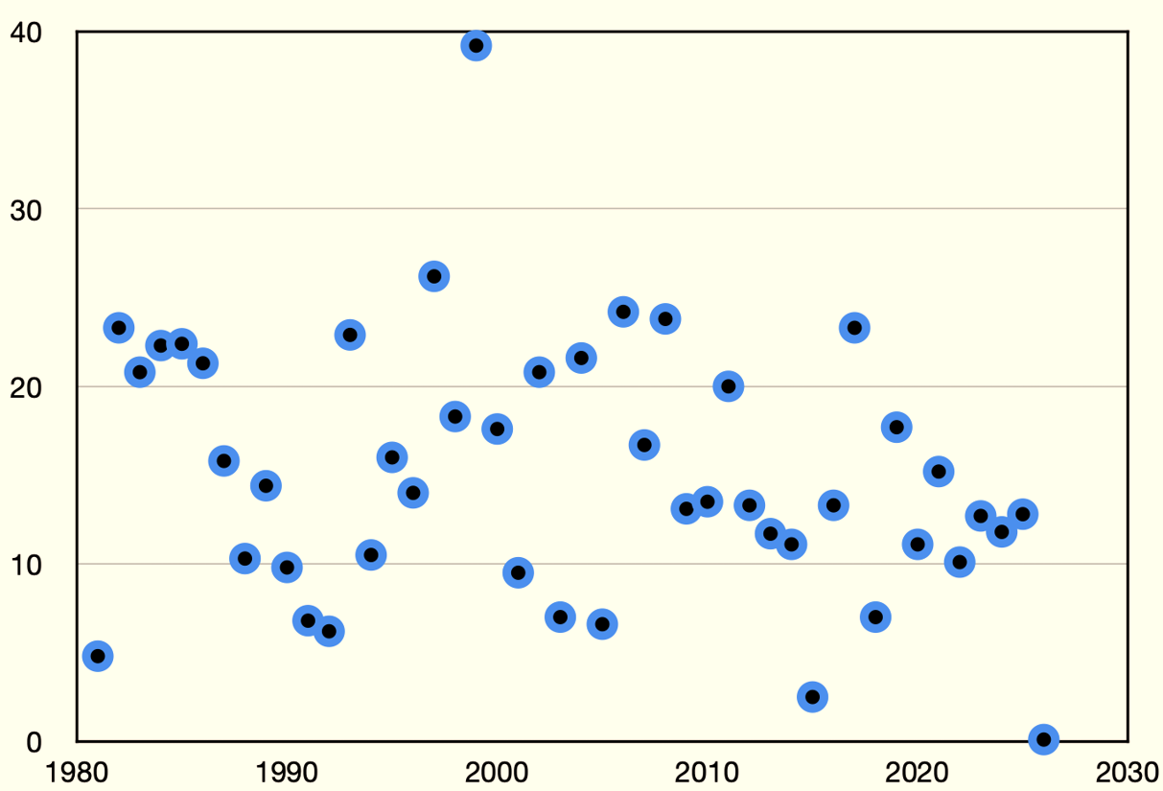
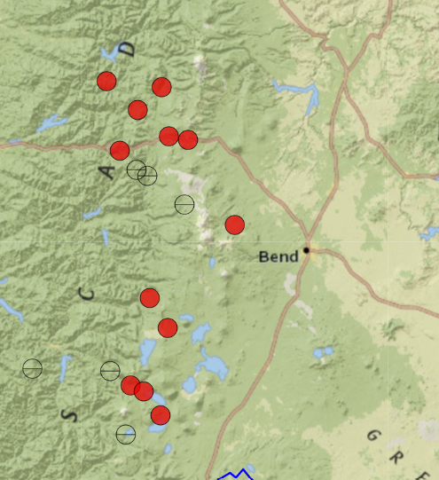
Three Creek Meadows SNOTEL Site hit ZERO Snow on March 7. When’s the last time that happened?
Three Creek Meadows SNOTEL SWE
On March 7 of every year since 1980
Three Creek
Meadows SNOTEL
Site 5680’
SWE (inches)
Year

Slide 52
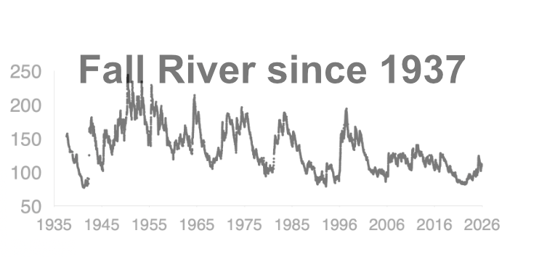
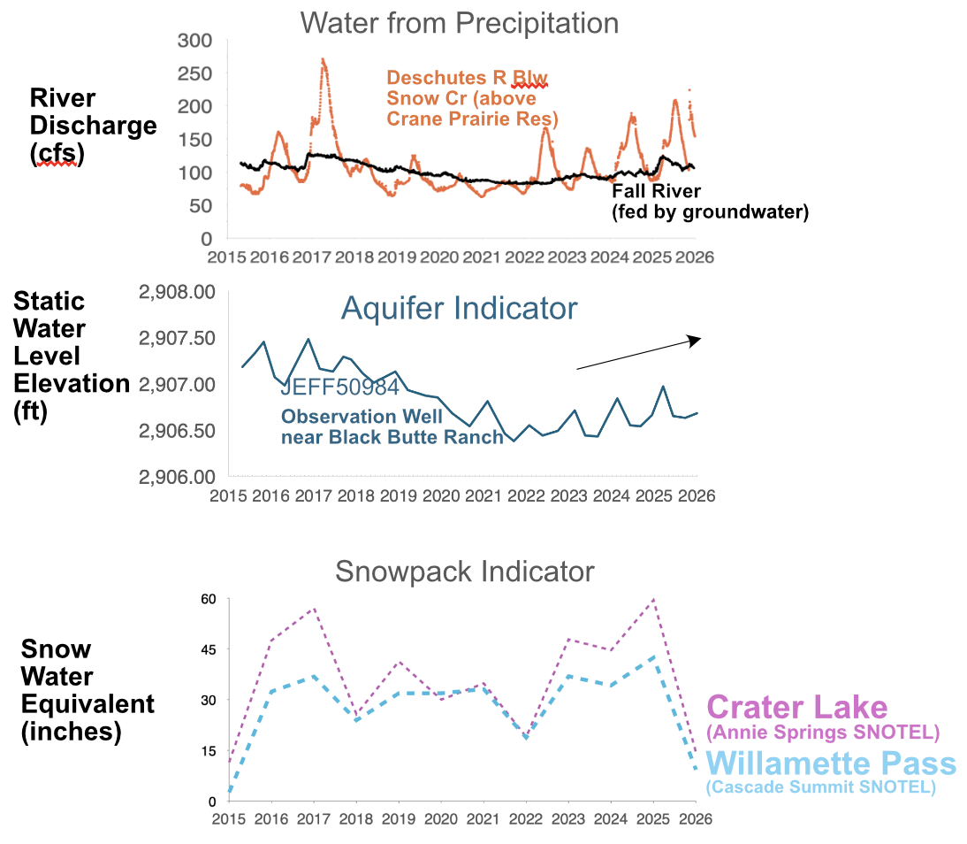
Water in the Upper Deschutes over the last 10 years

Slide 53
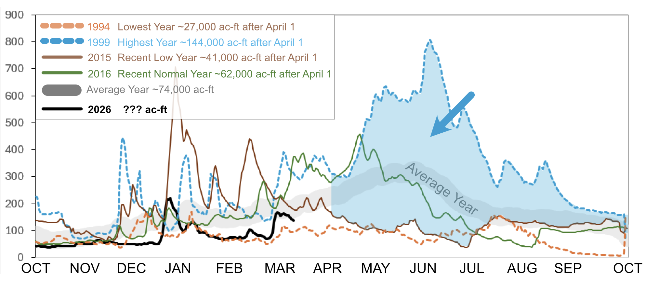
The Importance of Natural Flow, Little Deschutes River
*
*
~100,000 ac-ft of
Live flow for irrigation season
Discharge (cfs)
*
*Using Water Years 1981-2025
Water Year

Slide 54
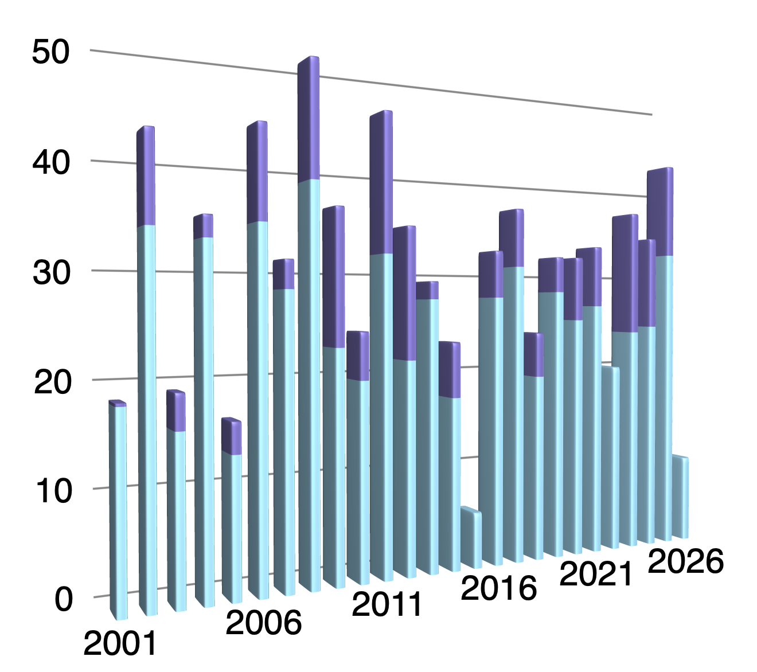
“If we get 30” of water in the snowpack at Cascade Summit by April 1st we will be alright.”-Awbrey Perry Deschutes Watermaster 1933-1960.
April 1
Snow Water Equivalent
(SWE) inches
Mar 17

Slide 55
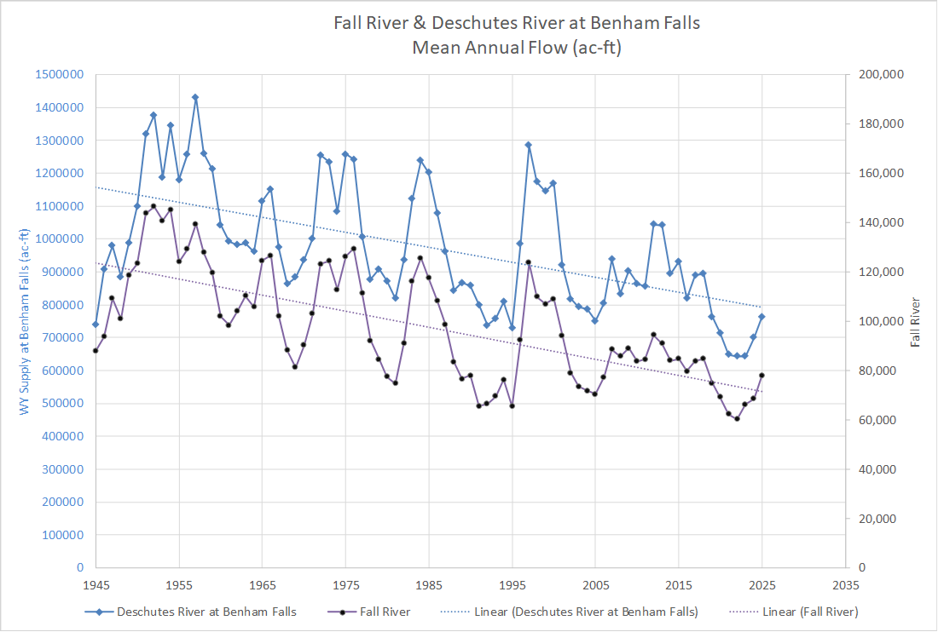
Benham Falls
Annual Volume AC-ft Benham Falls
Annual Volume AC-ft Fall River
Fall River
Water Year

Slide 56
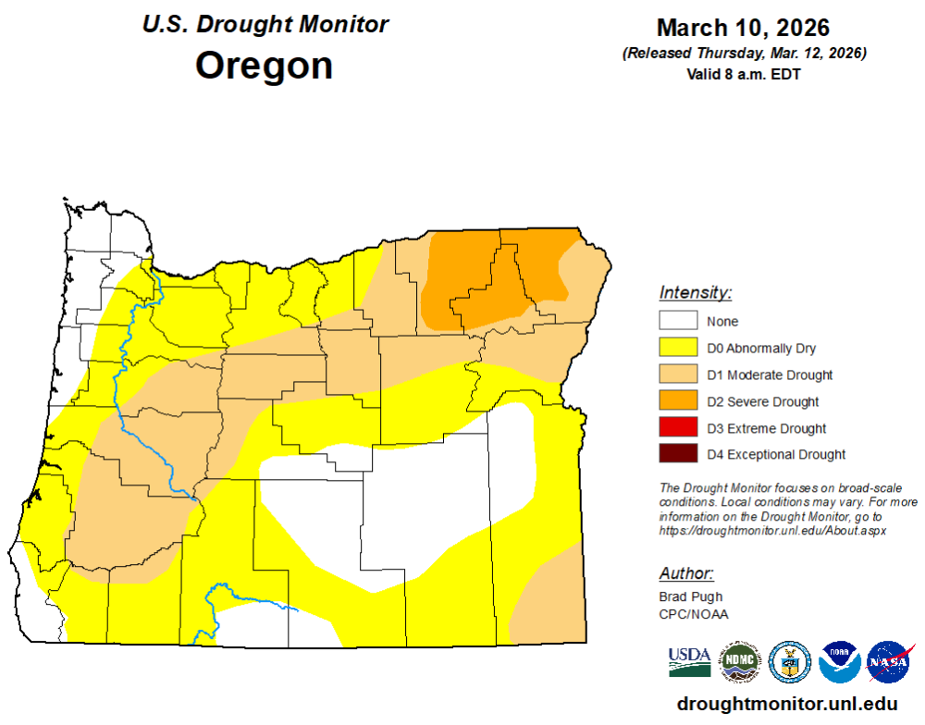

Slide 57
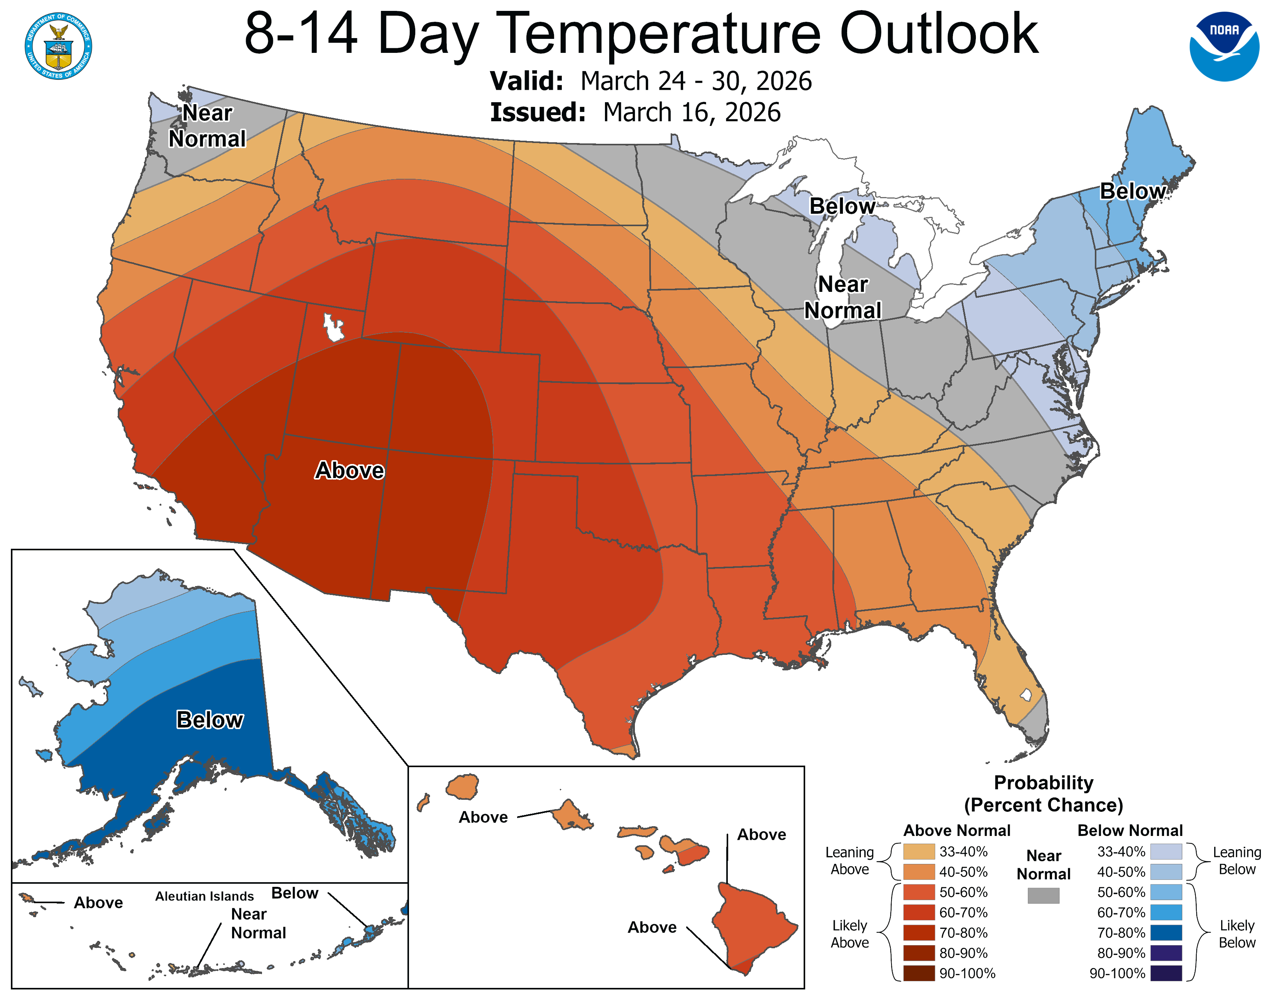

Slide 58
