Slide 1

Winterizing Cla-Val Valves (90 Series Focus)
TSID Work Session
10.21.2025

Slide 2

Session Objectives
Why winterization is critical
Cla-Val 90 series overview
Instructions for flowing vs. no-flow conditions
Safety & inspection tips
Reactivation in spring
Q&A

Slide 3
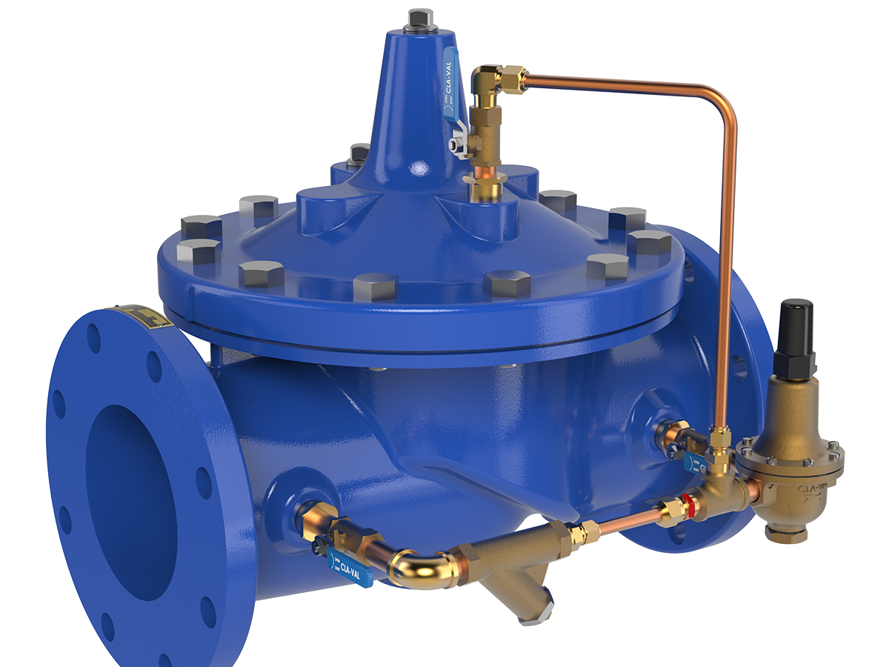
Why Winterize?
Freezing can block pilot system → valve failure
Cracking and damage to diaphragm or pilot tubing
Loss of flow control → irrigation disruption
Expensive repairs if valves freeze

Slide 4
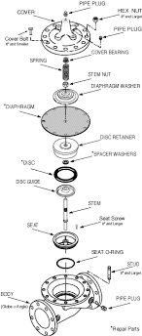
Cla-Val 90 Series Overview
Common models: 90-01, 90-21, 90-99
Pilot-operated pressure reducing valves
Key components: valve body, diaphragm, pilot controls, strainer

Slide 5

Common Freeze Risks
Pilot tubing
Valve cover chamber
Strainer housings
Low-point water traps
Drain/test cocks

Slide 6

Winterizing Under Flowing Condition
Add
Add insulation (commercial jackets, DIY wraps, straw, batts)
Add
Add heat (heat tape, small heaters in vault)
Best
Best: use both heat + insulation
Stop
Stop all leaks before insulating
Vent
Vent atmospheric drains outside insulation
Inspect
Inspect weekly during winter

Slide 7

Winterizing Under No Flow Condition (Deactivation)
Shut off line pressure (close pilot cocks & downstream block valve)
Disconnect cover tubing, vent cover chamber → valve opens
Close upstream block valve → main valve closes
Remove plugs (cover + inlet/outlet bosses) to drain fully
Disconnect and drain all pilot tubing
Loosen pilot valve cover screws to drain cavities
Ensure all cavities are drained
Secure fittings for re-activation

Slide 8

Reactivating in Spring
Replace all removed plugs
Reconnect drained pilot tubing
Tighten all fittings
Re-pressurize system (reverse shutoff sequence)
Bleed air from cover chamber & pilot high points
Follow standard startup procedure

Slide 9
Safety Considerations
Depressurize
Always depressurize before disconnecting tubing
Handle
Handle insulation materials safely
Use
Use only UL-listed heaters/tape
Avoid
Avoid open flame near insulation or straw
Wear
Wear PPE when working in vaults

Slide 10

Inspection Checklist
Weekly during winter (flowing condition)
Confirm insulation intact, no leaks or ice
Verify drains are vented correctly
Ensure heaters operating if installed

Slide 11

Resources & Support
Cla-Val O&M Manuals (90-01, 90-21, 90-99)
contact for support
541-977-TSID
www.cla-val.com/

